Slide 1
Image Colorization
Team Tensors:
Yee Zhian Liew
Lalitha Amudalapally
Sowndhariya Nandarajkumar

Slide 2
Introduction
In image colorization, our goal is to produce a colored image given a grayscale input image. This problem is challenging because it is multimodal --
a single grayscale image may correspond to many plausible colored images. As a result, traditional models often relied on significant user input
alongside a grayscale image.
Recently, deep neural networks have shown remarkable success in automatic image colorization going from grayscale to color with no additional
human input. This success may in part be due to their ability to capture and use semantic information in colorization, although we are not yet sure
what exactly makes these types of models perform so well.
Notes:
This problem is challenging because it is multimodal -- a single grayscale image may correspond to many colored images. Here the traditional models often relied on significant user input alongside a grayscale image.
Recently, deep neural networks have shown remarkable success in automatic image colorization going from grayscale to color with no additional human input.

Slide 3
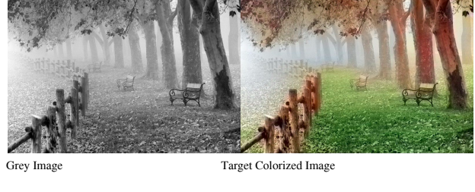
B/W Image → Color Image
Dataset : Series of 1000 photos from open dataset and DL website
Images: 256x256
Split : 70% train, 30% test.
Model : CNN and AutoEncoder + Fusion Layers
Notes:
We have used the download dataset which have series of 1000 photos and the size of the image was 256*256
And we splitted it as 70% training and 30 % testing
We used CNN and auto encoder with fusion layers

Slide 4
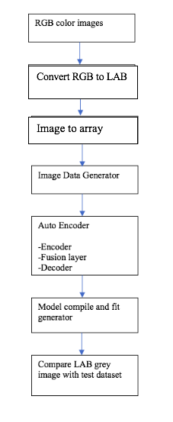
Architecture

Slide 5
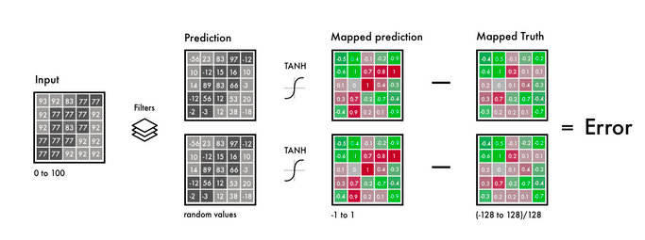
CIELAB
Notes:
L is the lightness intensity A channel is green red
B channel blue yellow’
Activation function is the tanh ,range is from -1 to 1

Slide 6
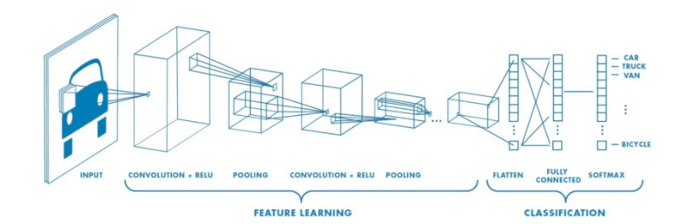
Convolutional Neural Network
Notes:
convolutional neural network (CNN, or ConvNet) is a class of deep neural networks, most commonly applied to analyzing visual imagery. ... CNNs use relatively little pre-processing compared to other image classification algorithms.

Slide 7
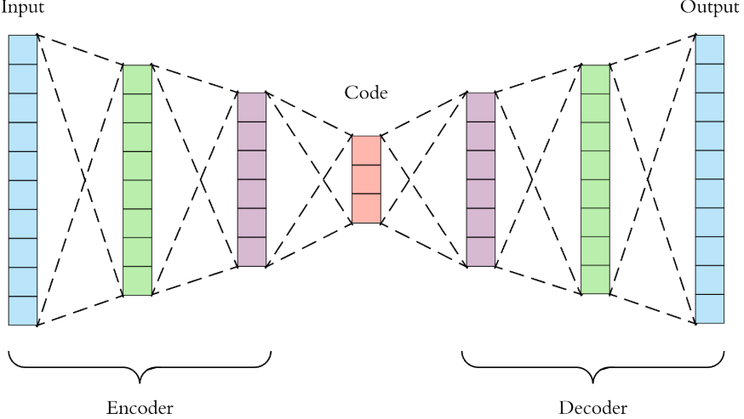
Auto Encoder
Notes:
An autoencoder is a type of artificial neural network used to learn efficient data codings in an unsupervised manner.
It aims to copy their inputs to their outputs.
They work by compressing the input into a latent-space representation, and then reconstructing the output from this representation.

Slide 8
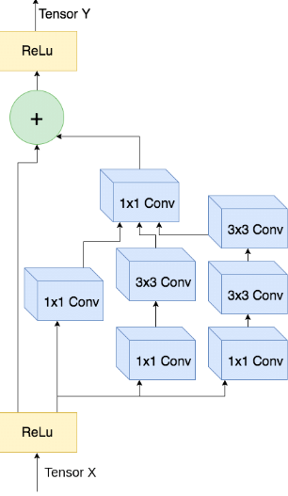
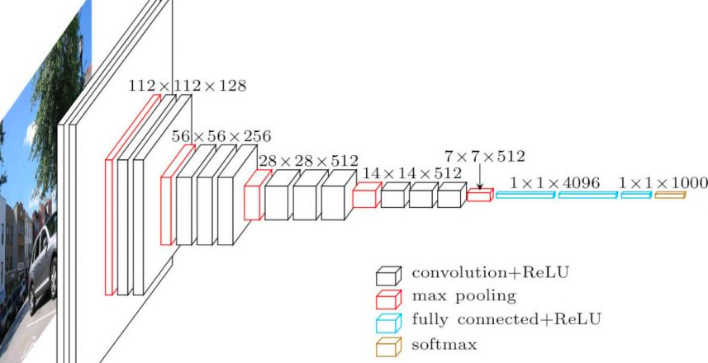
Pretrained Models
Inception ResNet v2
Xception Net
VGGNet 19
MobileNet v2
DenseNet
Notes:
Autoencoder pretrained models as fusion layers

Slide 9
Obstacles
Problem 1: Each Conv layer cuts images
Solution : Adding same padding - maintain image ratio
Problem 2: Max pooling increase information density but distort image
Solution : Stride decrease width and height by half, increase information density without distorting image
Problem 3: ReLu as the final activation(map to positive digit). Seen Red/yellow but not blue/green.
Solution: Adding a tanh activation function and mapping the Y values

Slide 10
Cont...
Problem 4: Computational Expensive
Solution: Image Data Generator
Problem 5 : Memorizing coloring
Solution : Adding pretrained model for Transfer Learning , and sense what’s picture and add color scheme
Problem 6: Pretrained model decrease image size/quality
Solution: Upsampling to double image size

Slide 11








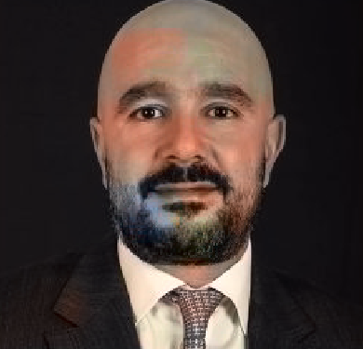



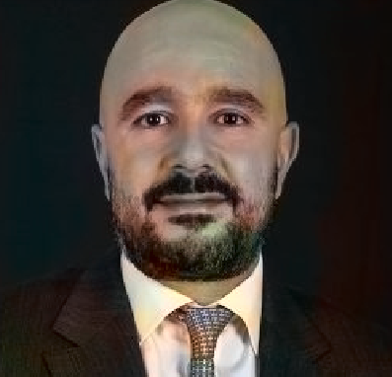
Results
Model | CNN | AE + Incep | AE+Xcep | AE+VGG | AE+Mob | AE+Dense
50 epochs
100 epochs
B/W image

Slide 12
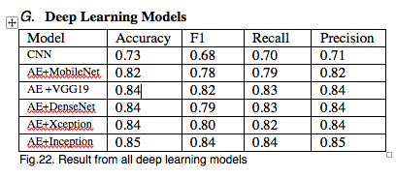

Slide 13
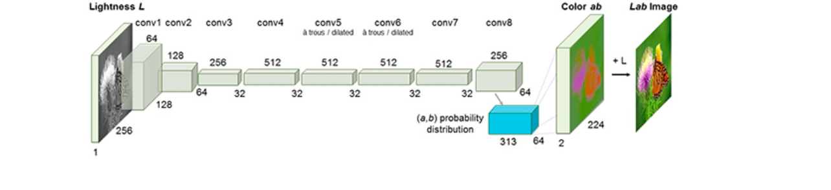
Real-time black and white video colorization with OpenCV
Notes:
This is how our model works

Slide 14
Model
Convert all training images from the RGB color space to the Lab color space
Use the L channel as the input to the network and train the network to predict the abchannels.
Combine the input L channel with the predicted ab channels.
Convert the Lab image back to RGB.`
Channels:
The L channel encodes lightness intensity only
The a channel encodes green-red.
And the b channel encodes blue-yellow
Notes:
.Converts images from RGB to LAB color space. It uses L channel as input to network and train the netwrok to predict the ab channels.
Combine the input L channel with predicted ab channel and converts to RGB images.

Slide 15
Cont..
Similar to Image colorization process except two additional imports
VideoStream allows us to grab frames from a webcam or video file
time will be used to pause to allow a webcam to warm up
Notes:
It is similar to still image colorization except two importd
Video stream and time.
Video stream takes video or webcam as input and makes in to frames.

Slide 16
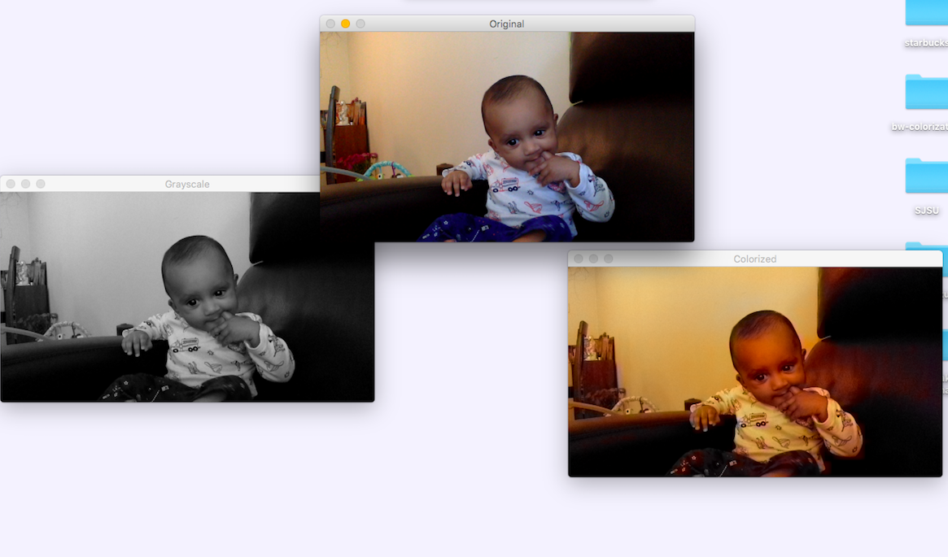
Screenshot

Slide 17
CODE DEMO

